Slide 1
Milestone Engineering Services
Precision • Innovation • Quality
Sales & service
wELCOME

Slide 2
Milestone Engineering Services
Precision • Innovation • Quality
Milestone Engineering Services since 2021 High Quality Products which contribute in giving Innovative solutions to our clients and there by increasing their productivity and profits. The MIG working towards the core values: Technical Support, Quality Service, Team spirit.
Milestone Engineering Services has abided by having a Motto "Keeping Customers First”, We strive to give Quality Solutions and Quality Service to customers.
Milestone Engineering Services provides Solution in Multi gauging, Fixture, Air gauges, Electronic Gauge, Air plug & Air Ring Gauges, Attribute Gauges, Plug gauge, Snap gauge, Ring gauge, Special Gauges, Assembly , Work holding which is our major strength compared to any supplier.

Slide 3
Customer Benefits
Industries We Serve
Our Core Strength
• Automotive OEMs
• Tier-1 & Tier-2 suppliers
• Automation machine builders
• General & precision engineering
• Automated multi gauging expertise
• OEM & automation-ready solutions
• Custom-built systems
• Strong service & technical support
• Competitive and value-driven pricing
Service & Support
• Installation & commissioning
• Operator training
• Calibration & technical support
• Fast service response
We support beyond sales.
• Reduced inspection time
• Higher productivity
• Consistent quality
• Automation-ready inspection
• Strong return on investment

Slide 4
About Us
Vision & Strengths
Milestone Engineering Services is a growing solution provider in precision instruments and automated multi gauging systems.
Founded in 2021, we support OEMs, automation integrators, and engineering industries with customized gauging solutions focused on accuracy, productivity, and reliability.
Provide leading-edge gauging and automation solutions
Customized solutions to improve productivity & profitability
Traceable measurements to international standards
Strong technical support and after-sales service

Slide 5
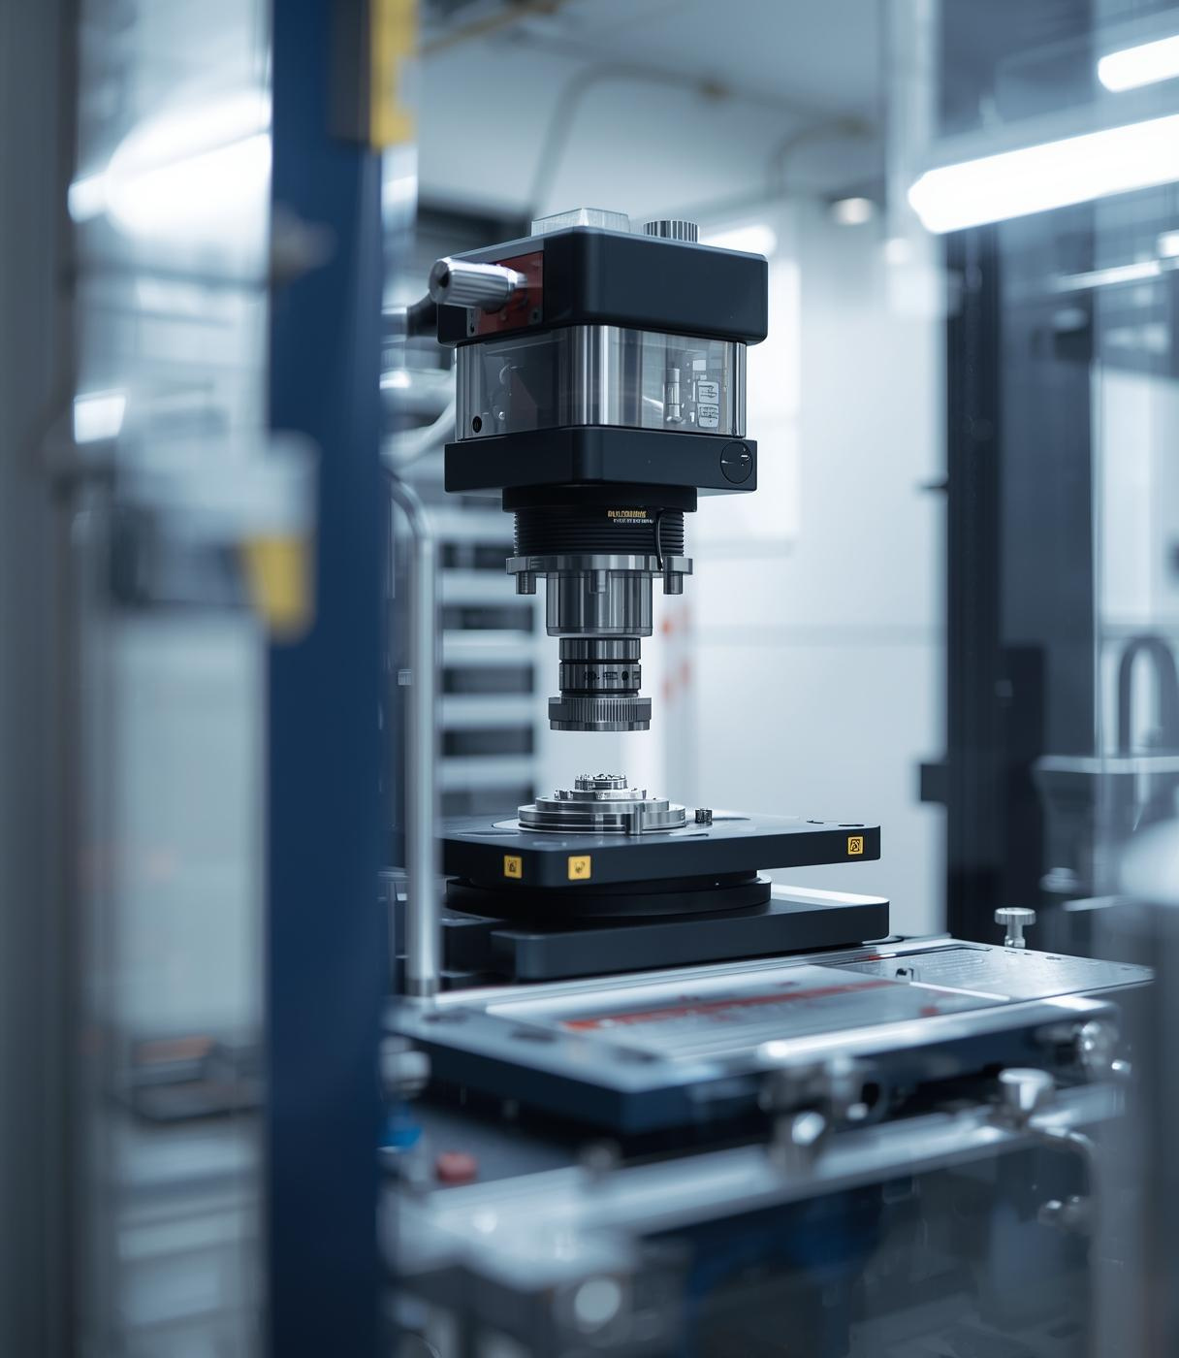
Precision
Gauging Solutions
Expert Solutions for OEM and Automotive Industries

Slide 6
Commitment to Excellence
Precision and Reliability in Every Solution

Slide 7
Quality Assurance
Uncompromising Standards and Solutions
Precision Focus
Customer Commitment
Our dedication to precision ensures that all products meet rigorous standards, thus fostering reliability and trust among our clients in the OEM and automotive manufacturing sectors.
We prioritize a customer-first approach, tailoring our solutions to meet specific needs, and ensuring client satisfaction through continuous support and innovation in our offerings.

Slide 8
Expertise in Gauging

Slide 9
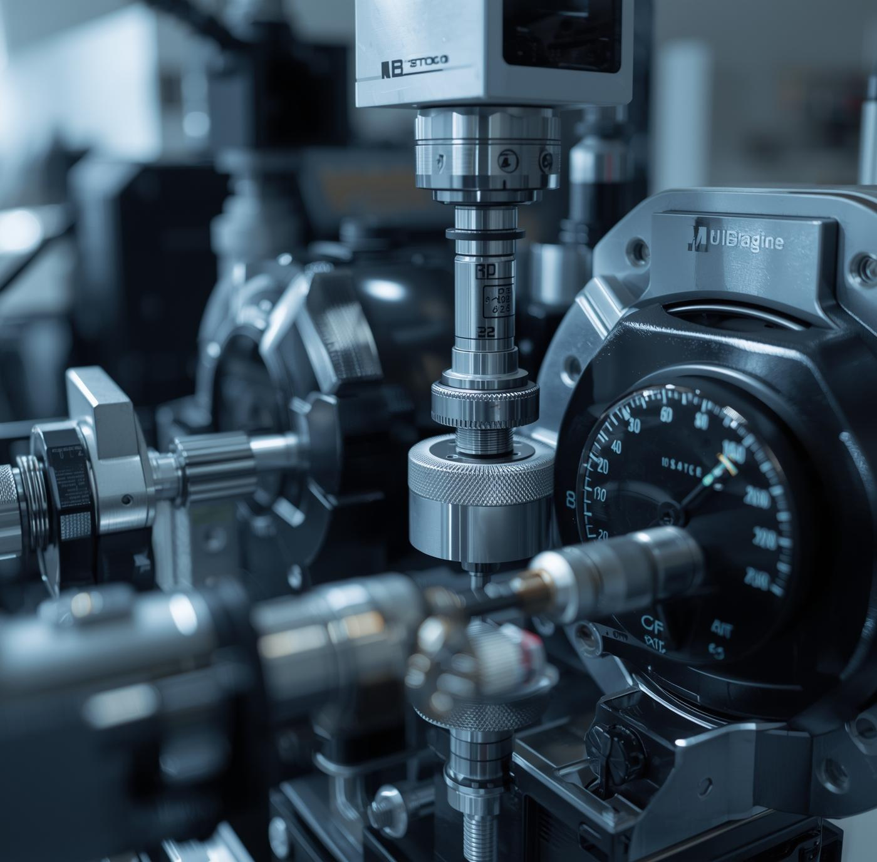
Multigauging Solutions
Advanced Precision
Our multigauging systems deliver unmatched accuracy and efficiency, enhancing your manufacturing process with innovative solutions tailored for OEM and automotive industries.

Slide 10
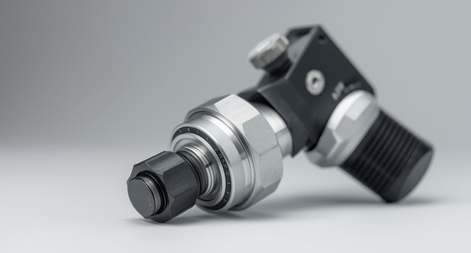
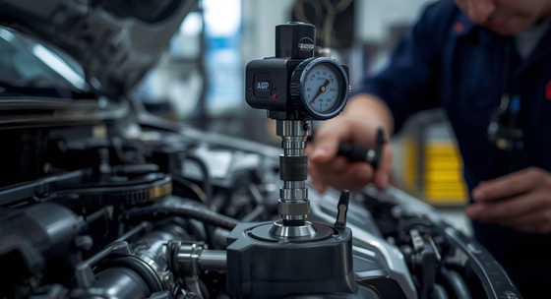
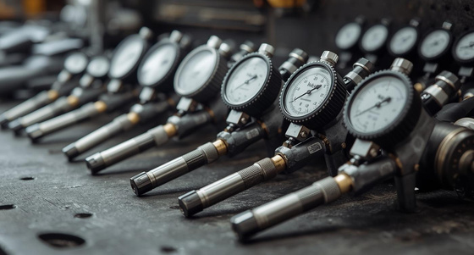
Air Gauging: Precision Through Compressed Air
Accurate Measurement
Air gauging ensures high precision in measurements.
Innovative Technology
Leveraging advanced air technology for reliable results.
Versatile Applications
Suitable for multiple industries, enhancing production efficiency.

Slide 11


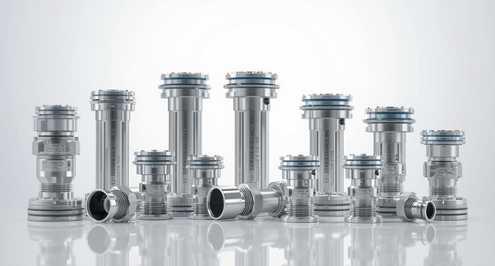
Precision-engineered Solutions for Every Need
Customization
Tailored fixtures for unique manufacturing requirements.
Versatility
Flexible designs that adapt to different applications.
Durability
Engineered to withstand rigorous manufacturing environments.

Slide 12
Innovation in Automation
The next level for your manufacturing
Enhanced Efficiency
Intelligent Integration
Our automation solutions significantly improve production efficiency by minimizing downtime and maximizing throughput, ensuring your manufacturing process is streamlined and cost-effective for optimal performance.
We focus on integrating advanced technologies that enhance precision and adaptability, allowing for seamless communication between systems and reducing the risk of errors throughout the production process.

Slide 13
Building Strong Partnerships
Collaboration
Our collaborative approach ensures tailored solutions that meet customer needs, enhancing efficiency and productivity in manufacturing processes.
Trust
We prioritize trust and transparency in every relationship, fostering long-term partnerships that drive mutual success and growth.

Slide 14
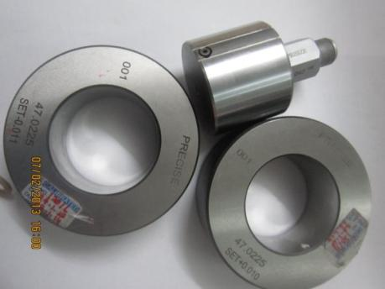
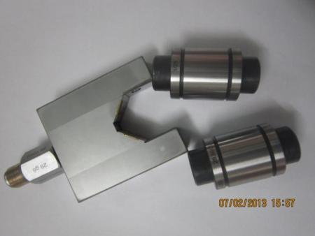
Milestone Engineering Services
Precision • Innovation • Quality
AIR PLUG GAUUGE TO CHECK ID BORE
Can be supplied for through bore / blind bore applications.
Adjustable depth collars can be provided for checking a specific depth.
Range: 2 mm to 200 mm.
Hard chrome plated.
Though / blind /step bore.
Two setting rings required.
AIR CALLIPER GAUGE TO CHECK OD
Range: 10mm to 180 mm Middle
Two setting masters required.
Offered with Snap Gauge with jet fixed in Carbide tip
Please specify the unit for which Air snap gauge is required.

Slide 15
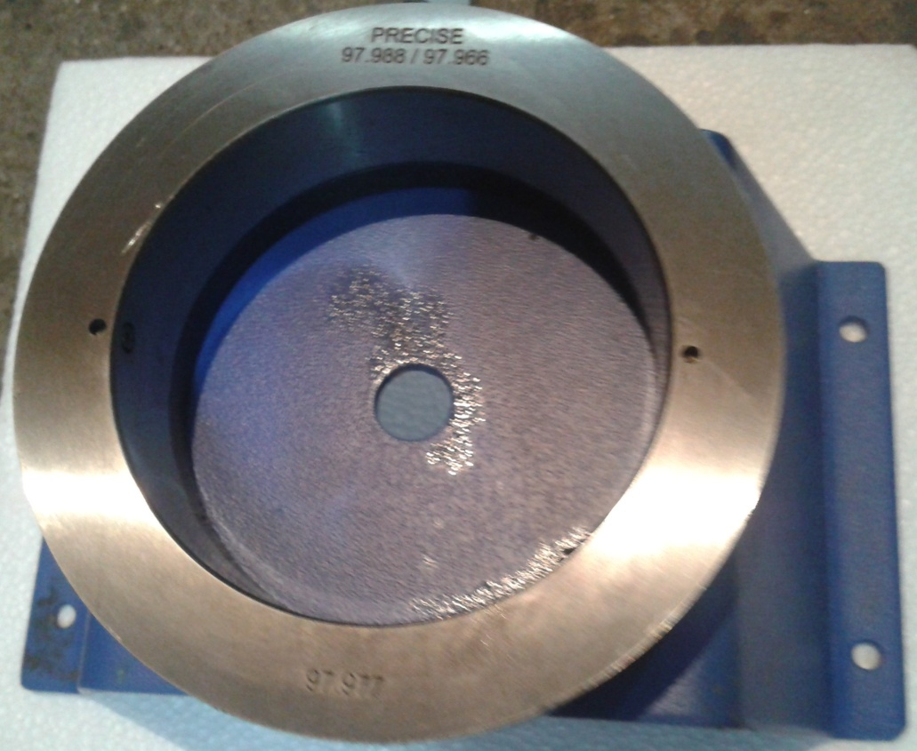
Milestone Engineering Services
Precision • Innovation • Quality
Two Jet Air Ring Gauge to check outside diameter, Taper & Ovality.
Three jet Air Ring Gauge for detecting Lobbing effect @ 120 Degrees
Can be supplied with Tungsten Carbide wear rings on request.
Air Ring gauge - above dia. 150 mm available on request.
AIR RING GAUGE TO CHECK OD

Slide 16
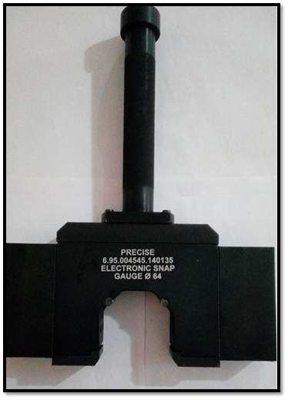
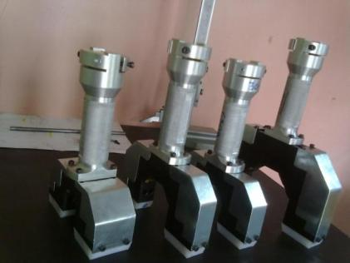
Milestone Engineering Services
Precision • Innovation • Quality
Electronic Calliper Gauge for OD 2 Point / 3 Point

Slide 17
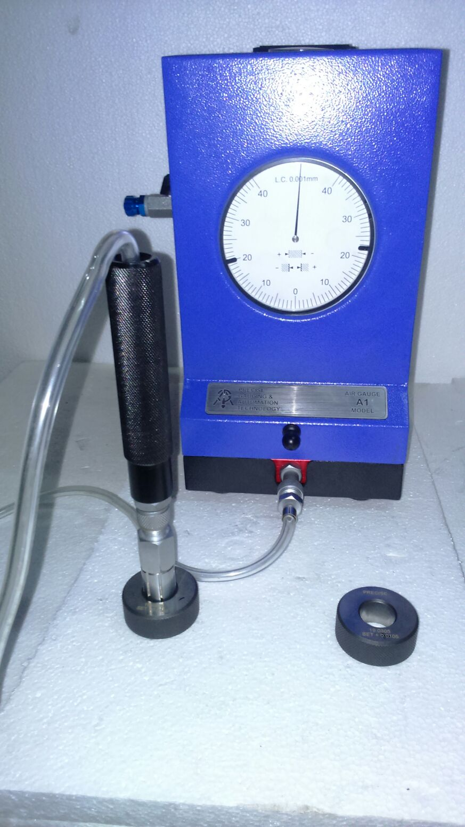
Milestone Engineering Services
Precision • Innovation • Quality
High pressure system - High speed of response and self cleaning of gauging area ensures accurate reading of size, taper and ovality at a time.
Non-contact Gauging - Long life due to minimal frictional wear.
Two Setting Masters - Ensures correct magnification of reading at all times.
System Pressure Check Gauge - provides a constant check on the system pressure i.e 3 bars (45 psi), regulated by a high precision regulator built in to the unit.
Minimum line pressure required 4.5 bars (67 psi)
Milestone Air Gauge Display Unit

Slide 18
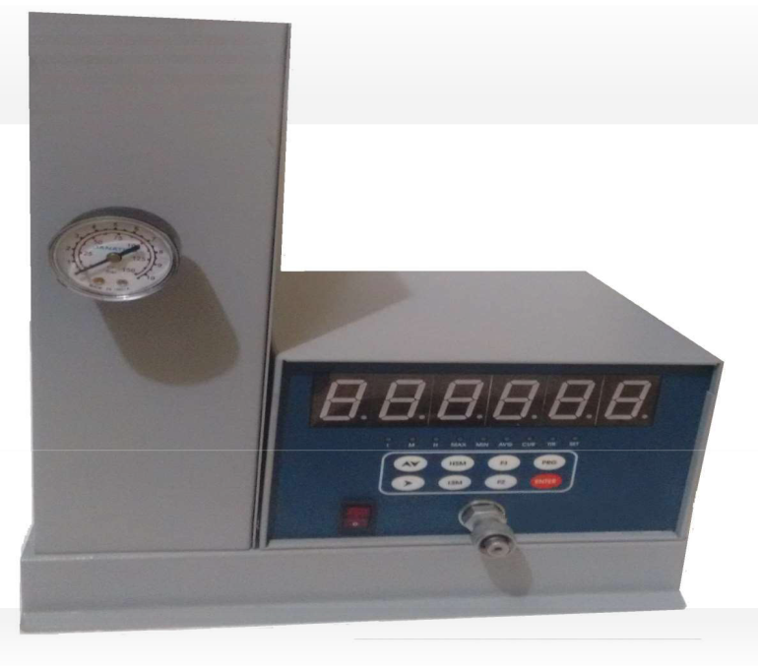
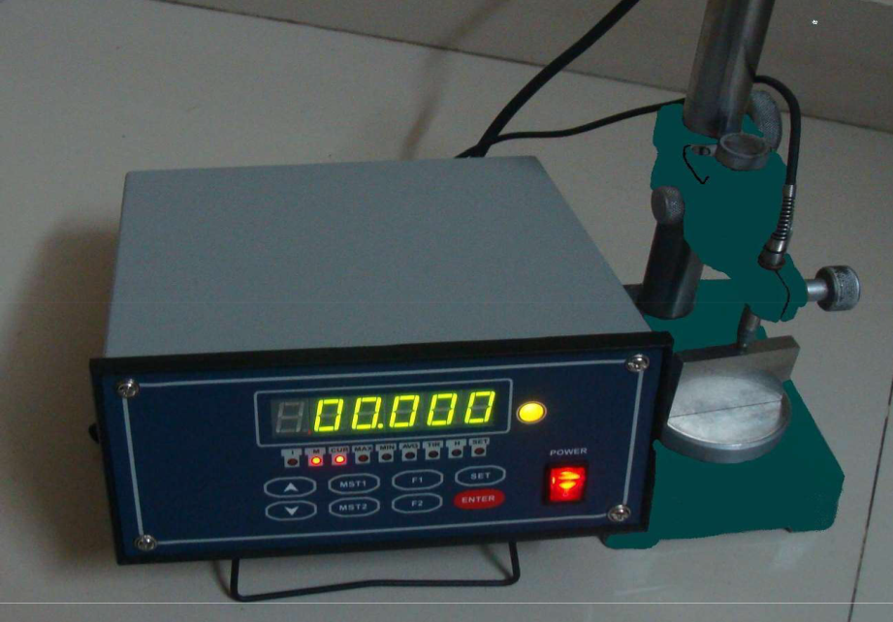
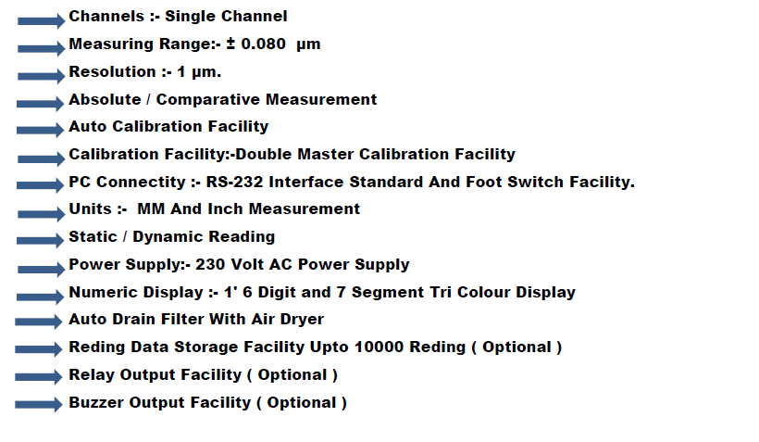
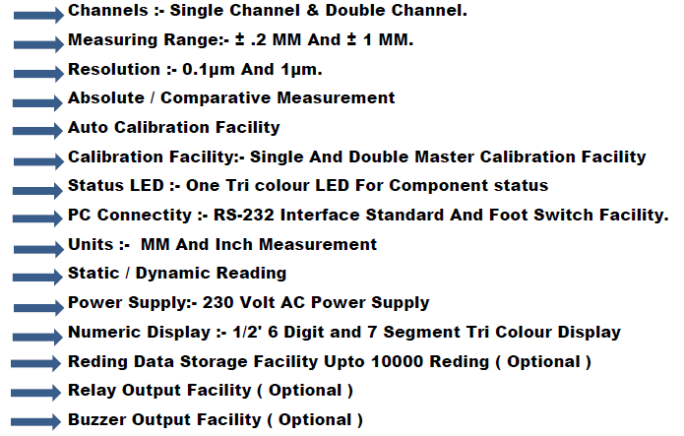
Milestone Engineering Services
Precision • Innovation • Quality
AIR ELECTRONICS TRI-COLOUR DIGITAL DISPLAY UNIT(B.D.)
TRICOLOURDIGITALDISPLAYUNIT

Slide 19
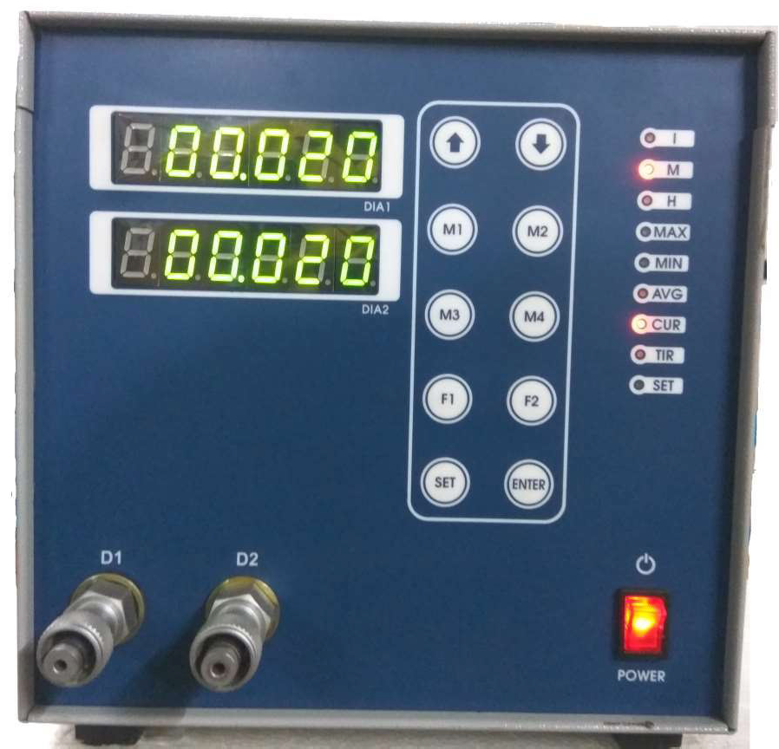
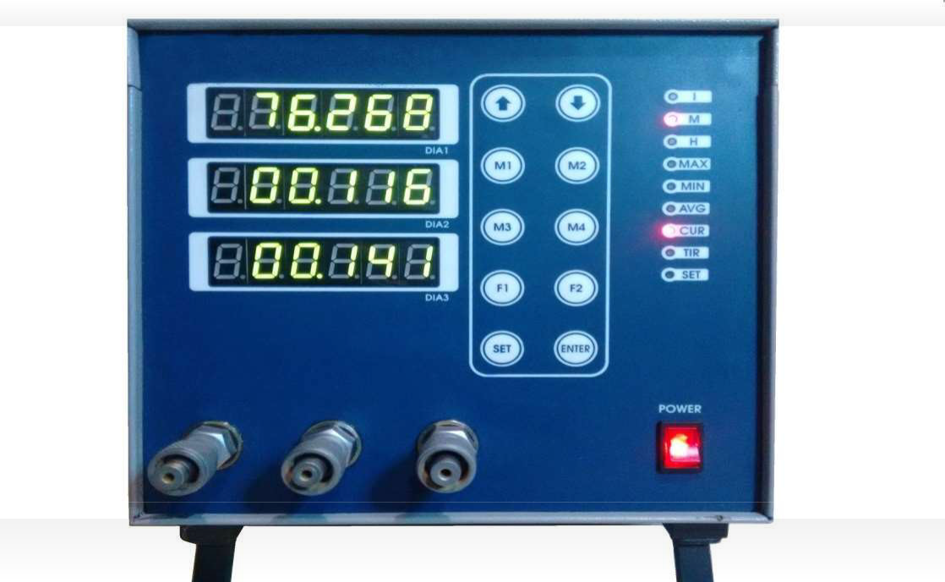
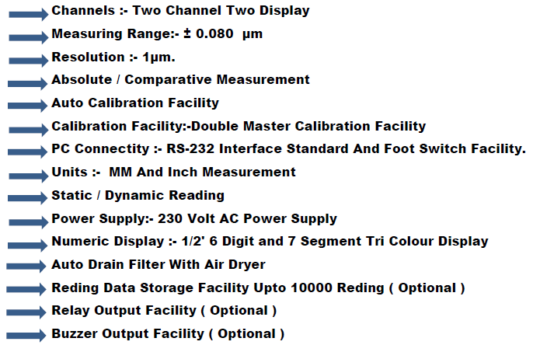
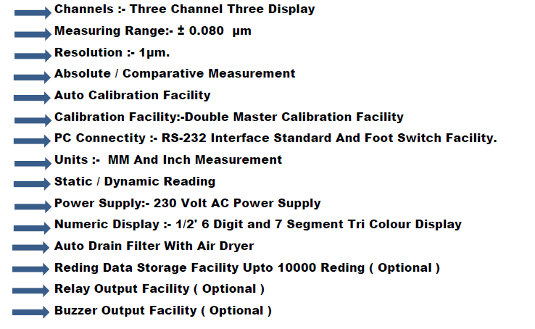
Milestone Engineering Services
Precision • Innovation • Quality
TWO CHANNEL TWO DISPLAY TRI COLOUR DIGITAL DISPLAY UNIT
THREE CHANNEL THREE DISPLAY TRI COLOUR DIGITAL DISPLAY UNIT

Slide 20
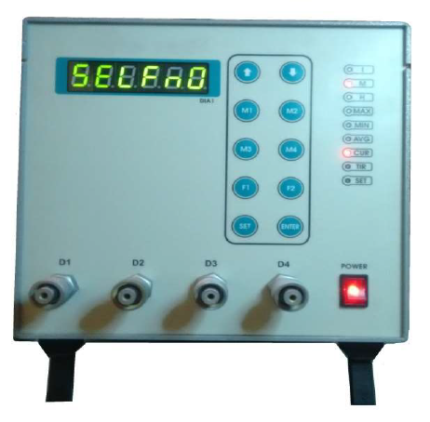
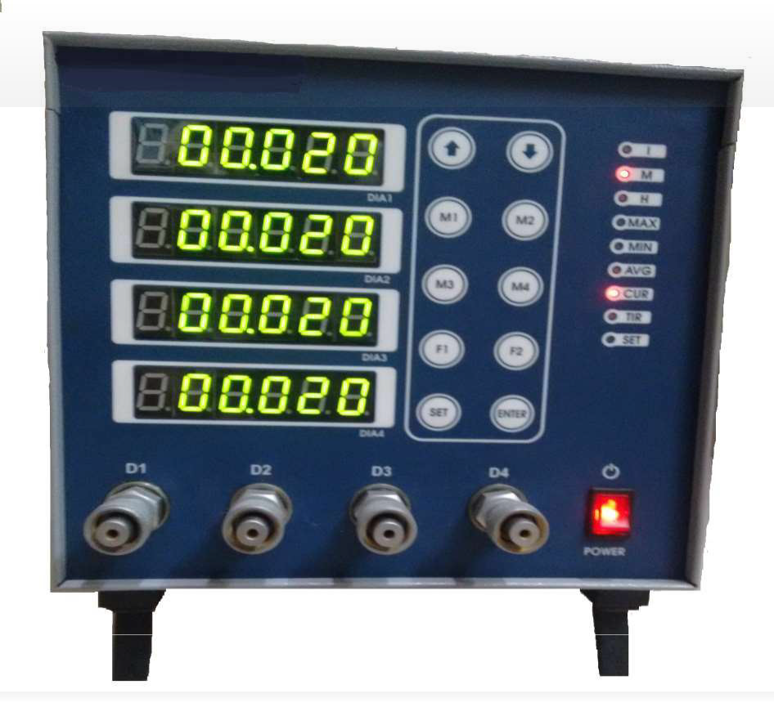
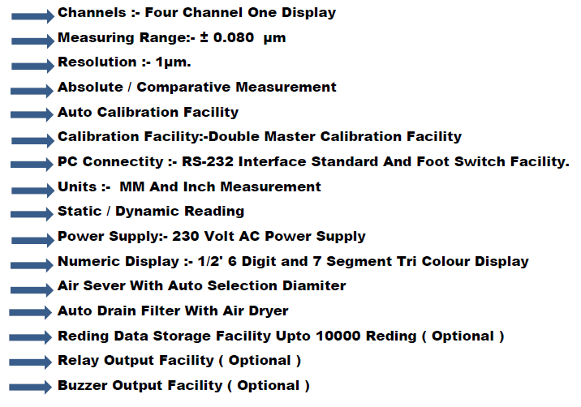
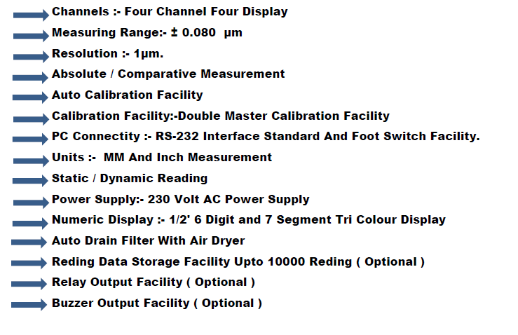
Milestone Engineering Services
Precision • Innovation • Quality
AUTO SELECTION WITH AIR SEVER TRI COLOUR DIGITAL DISPLAYUNIT
FOURCHANNELFOURDISPLAY TRICOLOURDIGITALDISPLAYUNIT

Slide 21
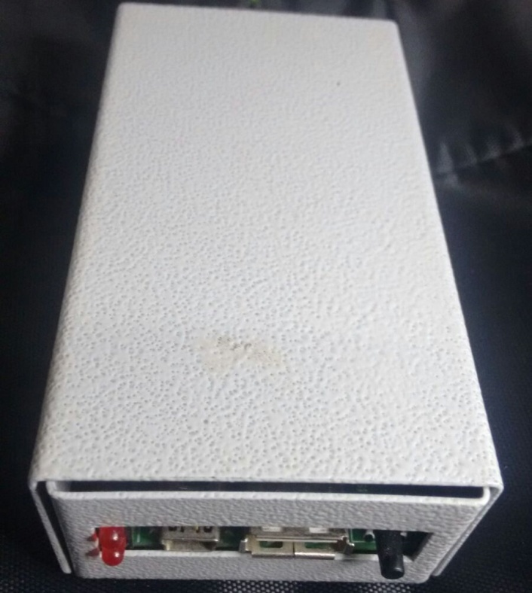
Milestone Engineering Services
Precision • Innovation • Quality
RS 232 Connectivity with Electronic DRO Type Unit
USB Connectivity with PC
10,000 Reading Storage Capacity
Memory Full LED indication
TIME & Date Stamp with each of recorded Reading
Saved Reading will be Opened in Excel File when connected to PC.
Data Can be Saved in PC & can be Used with any of the available SPC Software ( FOR e.g. MINITAB )
Data Modification possible with Excel File .
Milestone Memory Module Unit

Slide 22
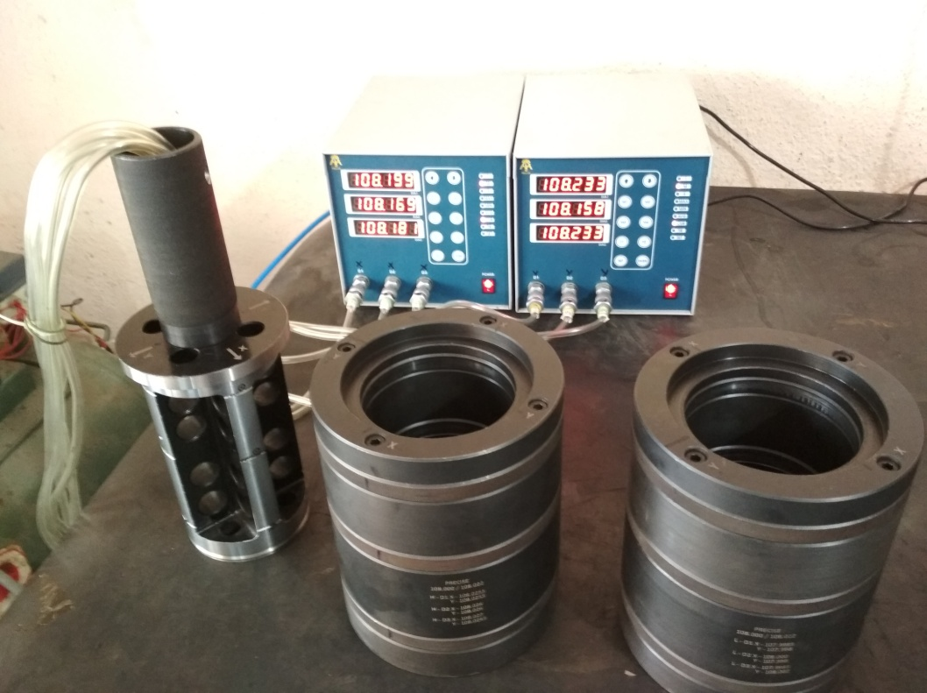
Milestone Engineering Services
Precision • Innovation • Quality
Engine BLOCK LINER BORE Multigauging Station
Tri-Color Six digit display
6 LINER ID DIA Measurement in X Axis at 3 Levels & Y Axis At 3 Levels
Absolute / Comparative Measurement
Auto calibration Facility
Metric/Inch Measurement
Static/Dynamic measurement
RS 232 Output
Relay Output 24 V Optional
Tricolour LED for component tolerance status
Suspended type 12 JET Special Air Plug Gauge
Special 3 Level Master Settings Rings for Setting of 3 Dia X & Y Axis hh

Slide 23
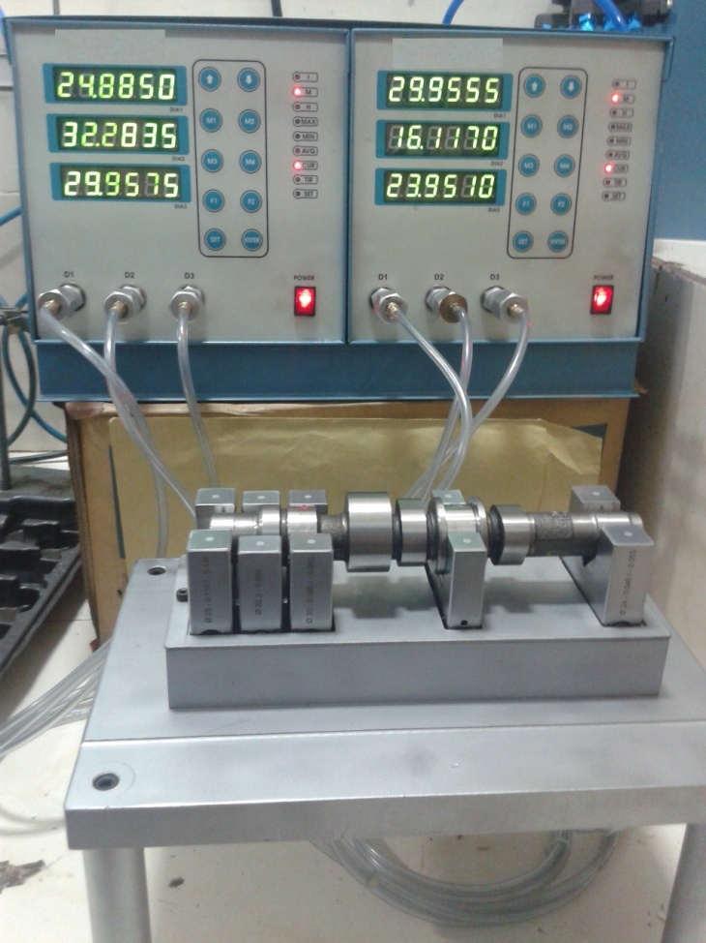
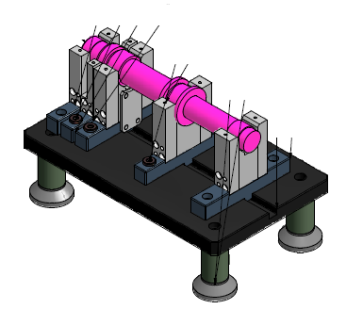
Milestone Engineering Services
Precision • Innovation • Quality
Tri-Color Six digit display
6 OD DIA Measurement
Absolute / Comparative Measurement
Auto calibration Facility
Metric/Inch Measurement
Static/Dynamic measurement
RS 232 Output
Relay Output 24 V Optional
Tricolour LED for component tolerance status
Ideal for Camshaft DIA Measurement
Camshaft Dia Multigauging Station

Slide 24
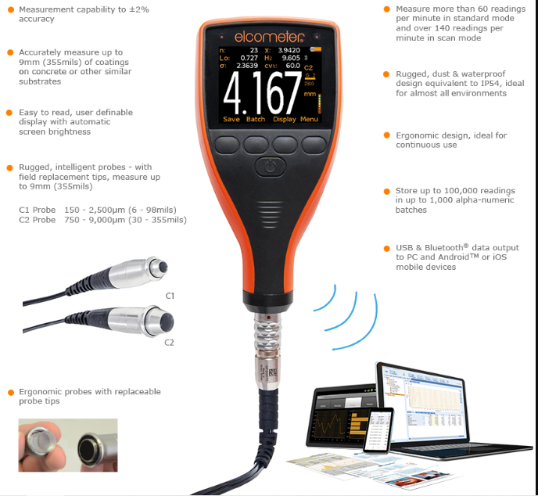
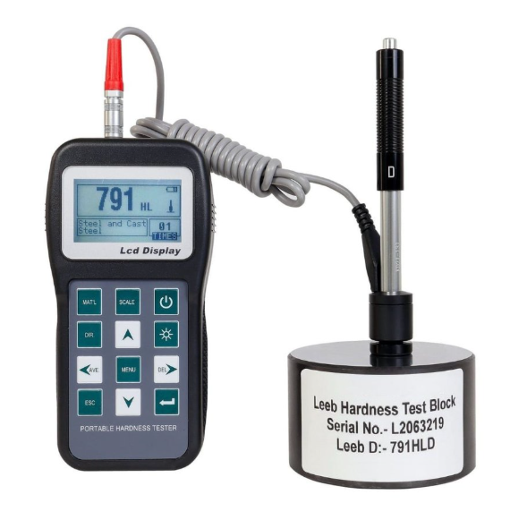
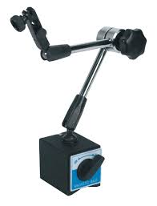
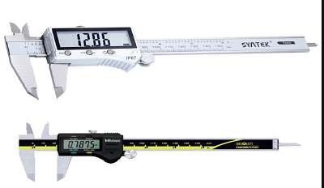
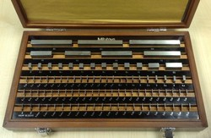
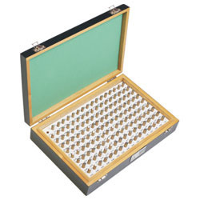
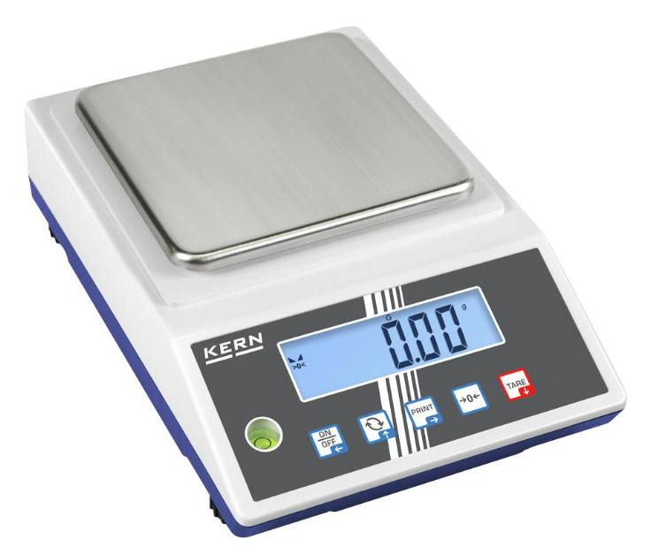
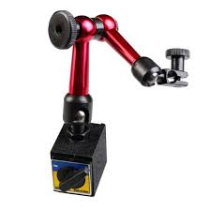
Milestone Engineering Services
Precision • Innovation • Quality
All type of Instruments, coating thickness, Slip gauge, magnetic stands etc…

Slide 25
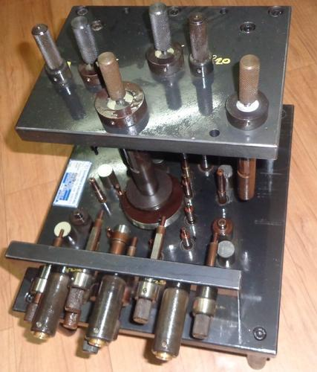
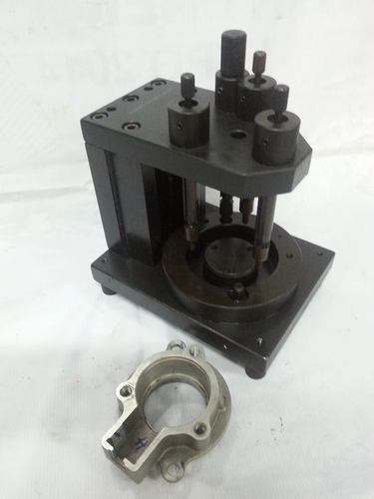
Milestone Engineering Services
Precision • Innovation • Quality
All type of special gauges & Fixtures

Slide 26

Contact Us
Connect with us to explore custom solutions tailored for your manufacturing needs.
Registered Details
Milestone Engineering Services
  41, Bajanai kovil Street,
  Mamandur village,Tiruttani,
  Tiruvallur District,
  Tamil Nadu, PIN 631201.
E-MAIL : milestonegauges@gmail.com, messalessarvices@gmail.com
Mobile No : +919445730673, +918220397439
THANK YOU.

